Slide 1
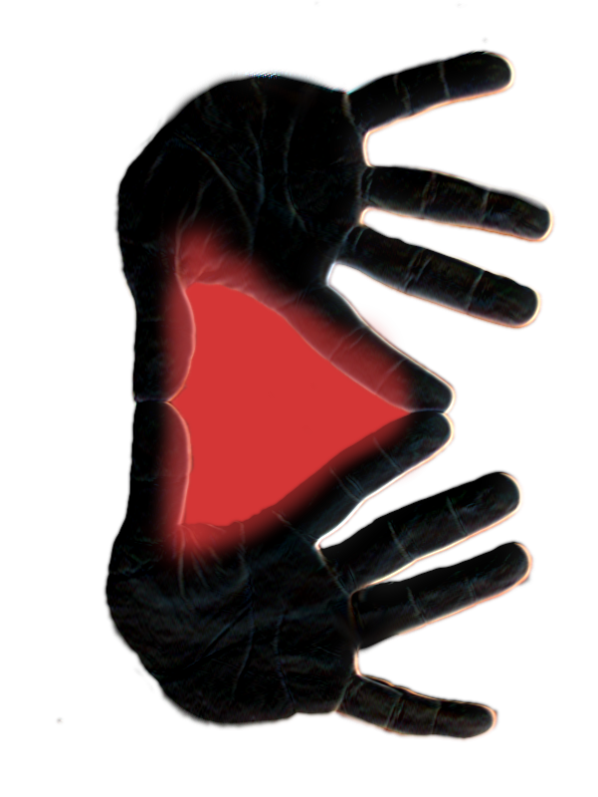
Live Editing System
Nofar Shaked
Advisor
Dr. Amnon Dekel

Slide 2

Concept
Youtube users upload:
Entertainment
News
Vlogs
Cats
Who cares?
Youtube partners
Viewers

Slide 3
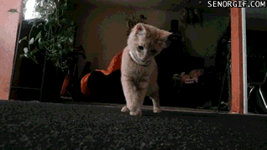
Concept
How are the videos made?
1. Idea
2. Filming
3. Editing
4. Uploading
D:<

Slide 4


Concept
How long does it take to get the video out of my head and into my channel?
Between minutes
to hours
Months
And even years

Slide 5
Concept
How can we reduce production time?
Faster editing
How fast?
No time at all
How?
Editing during filming

Slide 6
Goals
Providing a single system for:
FILMING
EDITING
UPLOADING
And enabling users to put their ideas out on the web, faster

Slide 7
The System
There are 3 main windows in the system:
1. Pre-production
Creating and editing projects
Adding and removing items in project
Editing items
All data, items, changes and settings are saved to external files, to be used later for recording or reopening of projects.

Slide 8
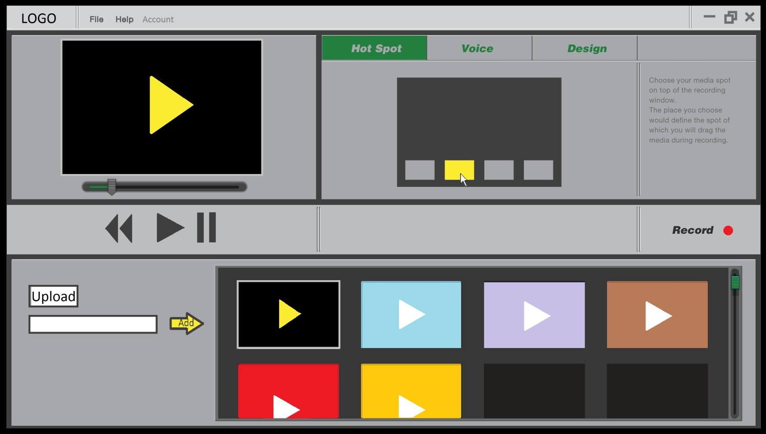
The System
There are 3 main windows in the system:
1. Pre-production

Slide 9
The System
There are 3 main windows in the system:
2. Recording
During the recording session, the users can insert and control items on screen while filming themselves.
This cancels the need to edit these items into the video after filming it

Slide 10
The System
There are 3 main windows in the system:
3. Uploading
The finished video is saved to the project’s folder on the user’s machine
The user can now upload the video directly to his/her Youtube channel
Of course, the user can also choose to record a new video or edit the project’s settings before trying again.

Slide 11
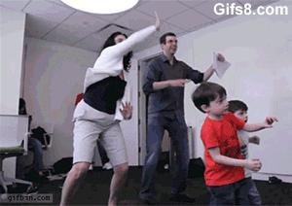
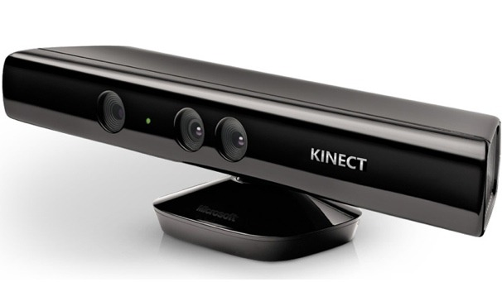
Kinect
L.E.S uses Kinect technology to recognize the user and use him/her as a controller.

Slide 12
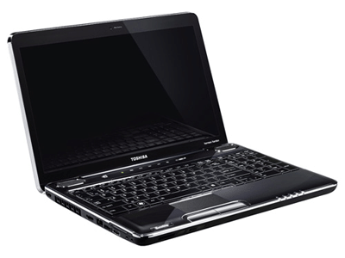
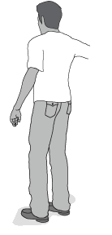

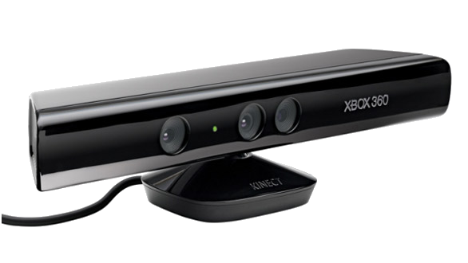
Kinect
Kinect SDK allow us to capture the human body as a set of joints, representing the positioning of the person’s limbs.
These joints can be used for controls and measurements, depends on code.

Slide 13
Kinect
The Kinect gives us the option to gain voice control over the system.
Using speech commands, the user activates items according to the project’s settings

Slide 14
Items
Pre-production screen creates Items
and adds them to an external file
Item
Item
Item
Item
Path
Type (video, image…)
Menu position
Screen pos x/y
Voice command
Path
Type (video, image…)
Menu position
Screen pos x/y
Voice command
Path
Type (video, image…)
Menu position
Screen pos x/y
Voice command
Path
Type (video, image…)
Menu position
Screen pos x/y
Voice command

Slide 15
Commands
The file is then being loaded in the Recording screen and all of the items are set to their position in the menu or have their voice commands added to the project’s grammar.
Right/Left hands joints are the controllers
The controllers’ positions are used to choose from the menu, drag items across the screen, resize the items and close them.
“Food”
“Money”
“Money” item
“Money”

Slide 16
Screen Capturing
Bytescout Screen Capturing SDK is used to record all graphic data from screen and all audio.
From this moment, any movement caught by camera and every item appearing on screen are recorded to a video.

Slide 17
Finished Video
The saved video is located inside the project’s folder. The user can access it from outside the system for farther editing.
Google API is used to upload the video directly to a user’s Youtube channel.

Slide 18
Issues and Problems
Kinect abilities
The Kinect is not suitable for short range work. Right now, the system can help in creating long shot videos, capturing most of the body.
Similar problems appear in other depth cameras.

Slide 19
Future Work
Fully utilize Kinect’s potential
Multiple users
Avatarring
Using depth capture in all dimensions
More user friendly
Tutorials
GUI
More editing control

Slide 20
Thank You
You can ask me questions or you can go have snacks

